Slide 1


Slide 2
What is CloudHour?
Objective of CloudHour
Round-table discussion
Focus on a few key topics
Why It's Important
Rapid changes in cloud security and tech
Stay updated and connected for growth as community
How it will benefit the community
Real-time engagement with hosts and community members
Ask open questions and speak your opinion
Opportunity to affect the next agenda
Notes:
Objective of CloudHour
The objective of CloudHour is to create a collaborative space where professionals can come together to discuss, learn, and share insights on the most pressing topics in cloud security and modern workplace technology.
Why its important
CloudHour is important because, in the rapidly evolving landscape of cloud security and workplace technologies, staying updated and connected is crucial for career growth and organizational resilience
How it will benefit the community
By attending CloudHour, community members will have the unique opportunity to engage with industry experts in real-time, ask questions, network with like-minded professionals, and even have the chance to contribute their own expertise by becoming guest speakers in future episodes.

Slide 3

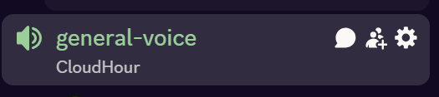
If you prefer to not talk or be asked questions press mute
Open Mic is allowed
Remember to open the chat

Slide 4
Links to share
Azure Information Protection: Enable MFA for your Azure tenant (MC1143999)
Action Required - Update Conditional Access policies for Azure DevOps Sign-ins (MC1123830)
Migrate from legacy policy settings to Authentication Methods
Getting Started with Intune - Some things to watch
Notes:
Azure Information Protection: Enable MFA for your Azure tenant (MC1143999)
MC1143999 - Azure Information Protection: Enable multifactor authentication for your Azure tenant by October 1, 2025 | Microsoft 365 Message Center Archive
https://mc.merill.net/message/MC1143999
Action Required – Update Conditional Access policies for Azure DevOps Sign-ins (MC1123830)
MC1123830 - Microsoft Entra: Action Required – Update Conditional Access Policies for Azure DevOps Sign-ins | Microsoft 365 Message Center Archive
https://mc.merill.net/message/MC1123830
Migrate from legacy policy settings to Authentication Methods
How to migrate to the Authentication methods policy - Microsoft Entra ID | Microsoft Learn
https://learn.microsoft.com/en-us/entra/identity/authentication/how-to-authentication-methods-manage
Getting Started with Intune – Some things to watch
Getting Started with Intune – Some things to watch – Andrew Taylor
https://andrewstaylor.com/2025/08/20/getting-started-with-intune-some-things-to-watch/

Slide 5
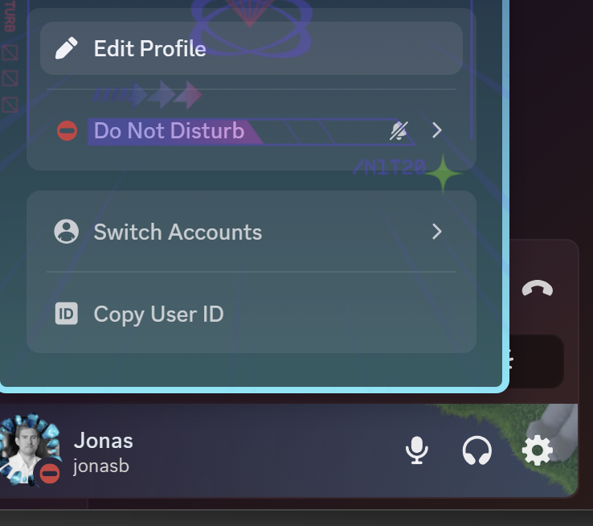


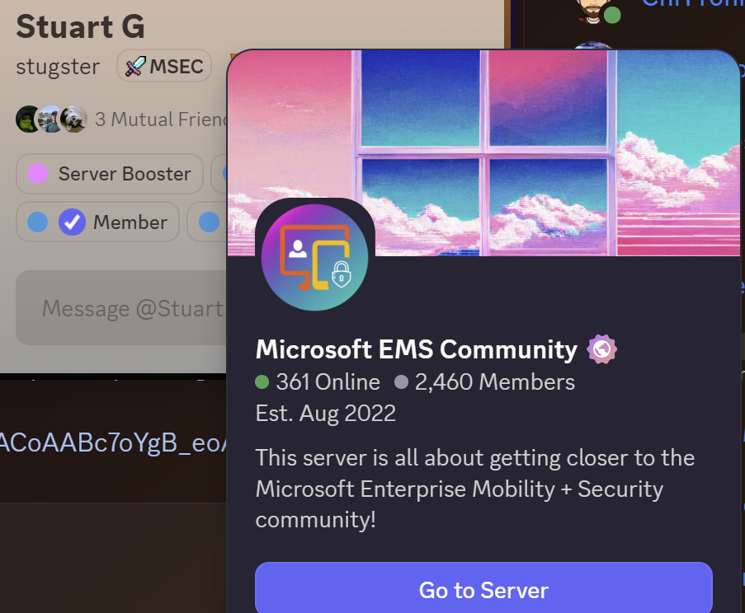
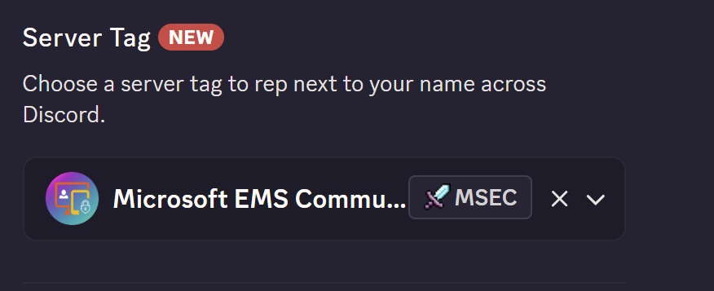
Discord Server tag
1
2

Slide 6
Agenda
Intune
Entra
Protect against shadow AI
Community tools/scripts

Slide 7
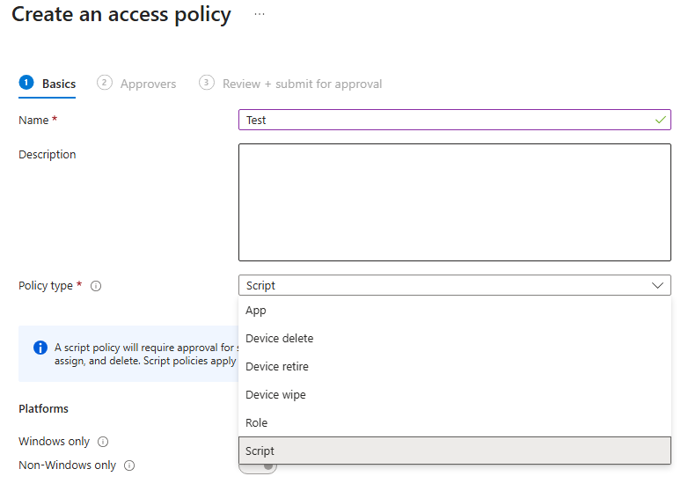
Intune
Windows 10 EOL
Windows 10 EOL on 14th of October are you ready? If not get started today!
Windows Backup
Want to take backup of system settings, credentials and Microsoft Store apps? Windows Backup might be able to help you.
Manage individual Quality Update
Enforce quality update during OOBE and start with the latest security and quality updates. It's available to activate in your ESP.
Multi admin approval
Is a second opinion needed before a change is applied? Perhaps protect against a compromised admin account? MAA can help you with that!

Slide 8
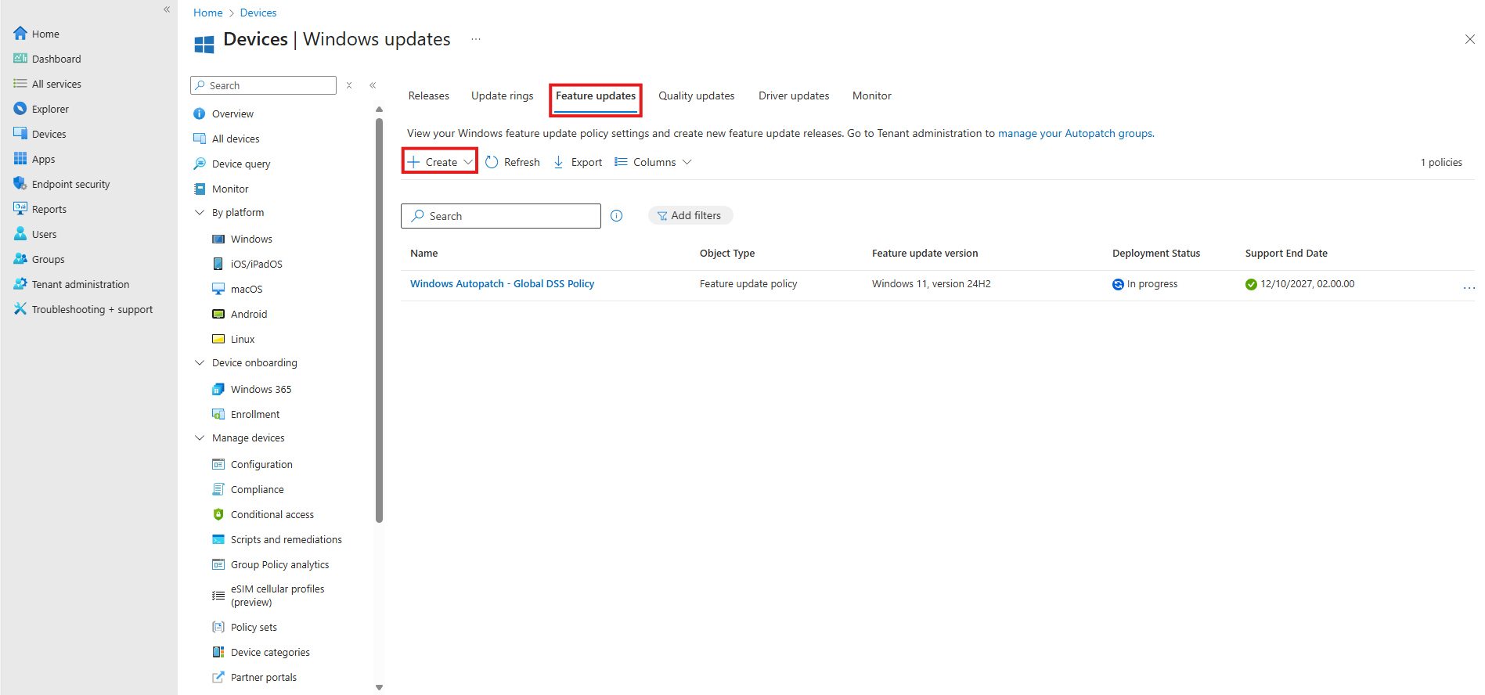
Windows 10 EOL
Windows 10 EOL – 14th of October
What is your plan?
Extended Security Updates
Get started upgrading with Windows Autopatch now!
Notes:
Extended Security Updates
Extended Security Updates (ESU) program for Windows 10 | Microsoft Learn

Slide 9
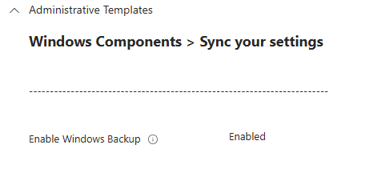
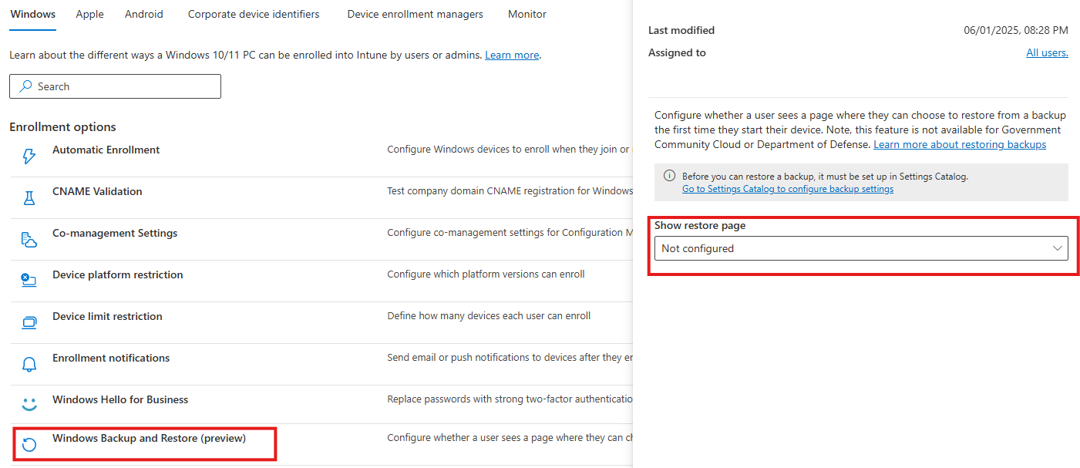
Windows Backup
Windows 10/11 devices, must be either Entra or Hybrid joined.
Windows System Settings, Microsoft Store Apps (Start Menu) and Credentials.
Restore the settings during OOBE, when provisioning a new device!
Do you plan to use it?
Notes:
https://learn.microsoft.com/en-us/intune/intune-service/enrollment/windows-backup-restore

Slide 10
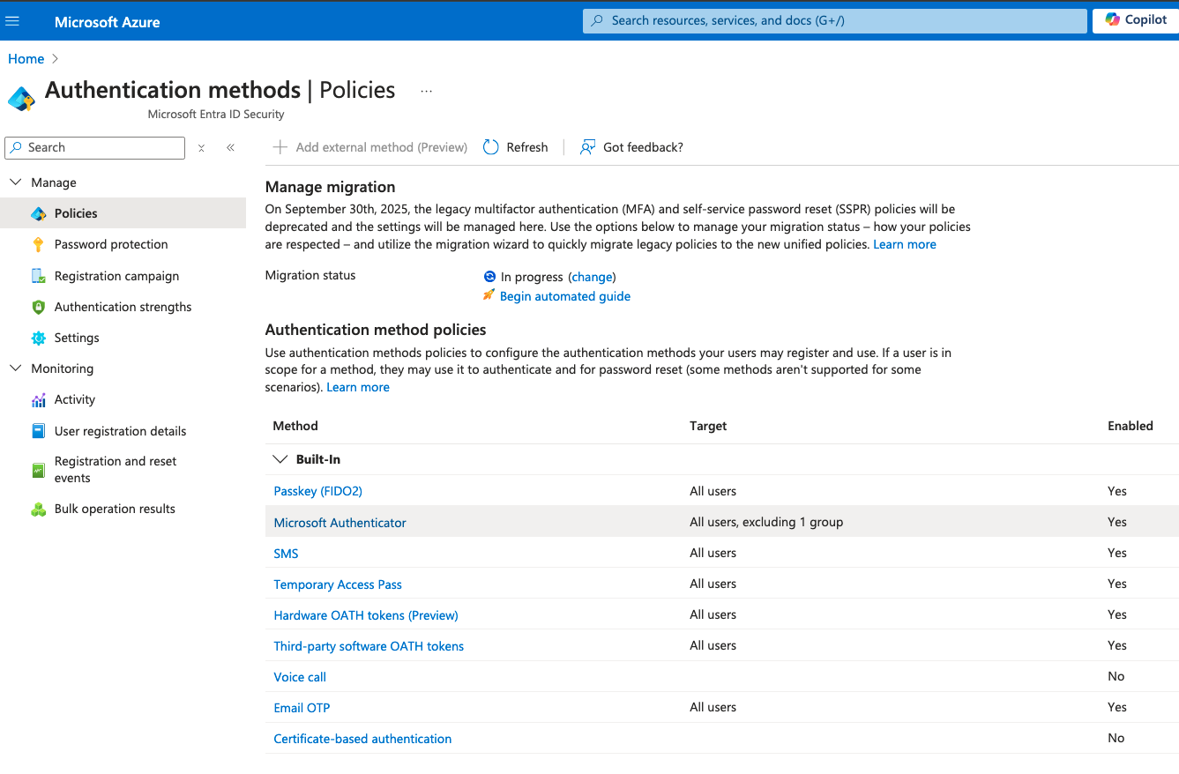
Legacy Auth methods EOL

Slide 11
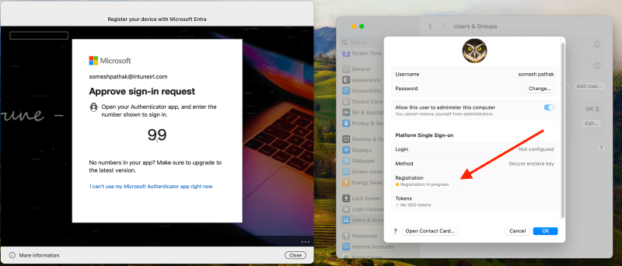
macOS PSSO
Notes:
https://intuneirl.com/implementing-platform-sso-for-macos-a-deep-dive-into-configuration-troubleshooting/

Slide 12
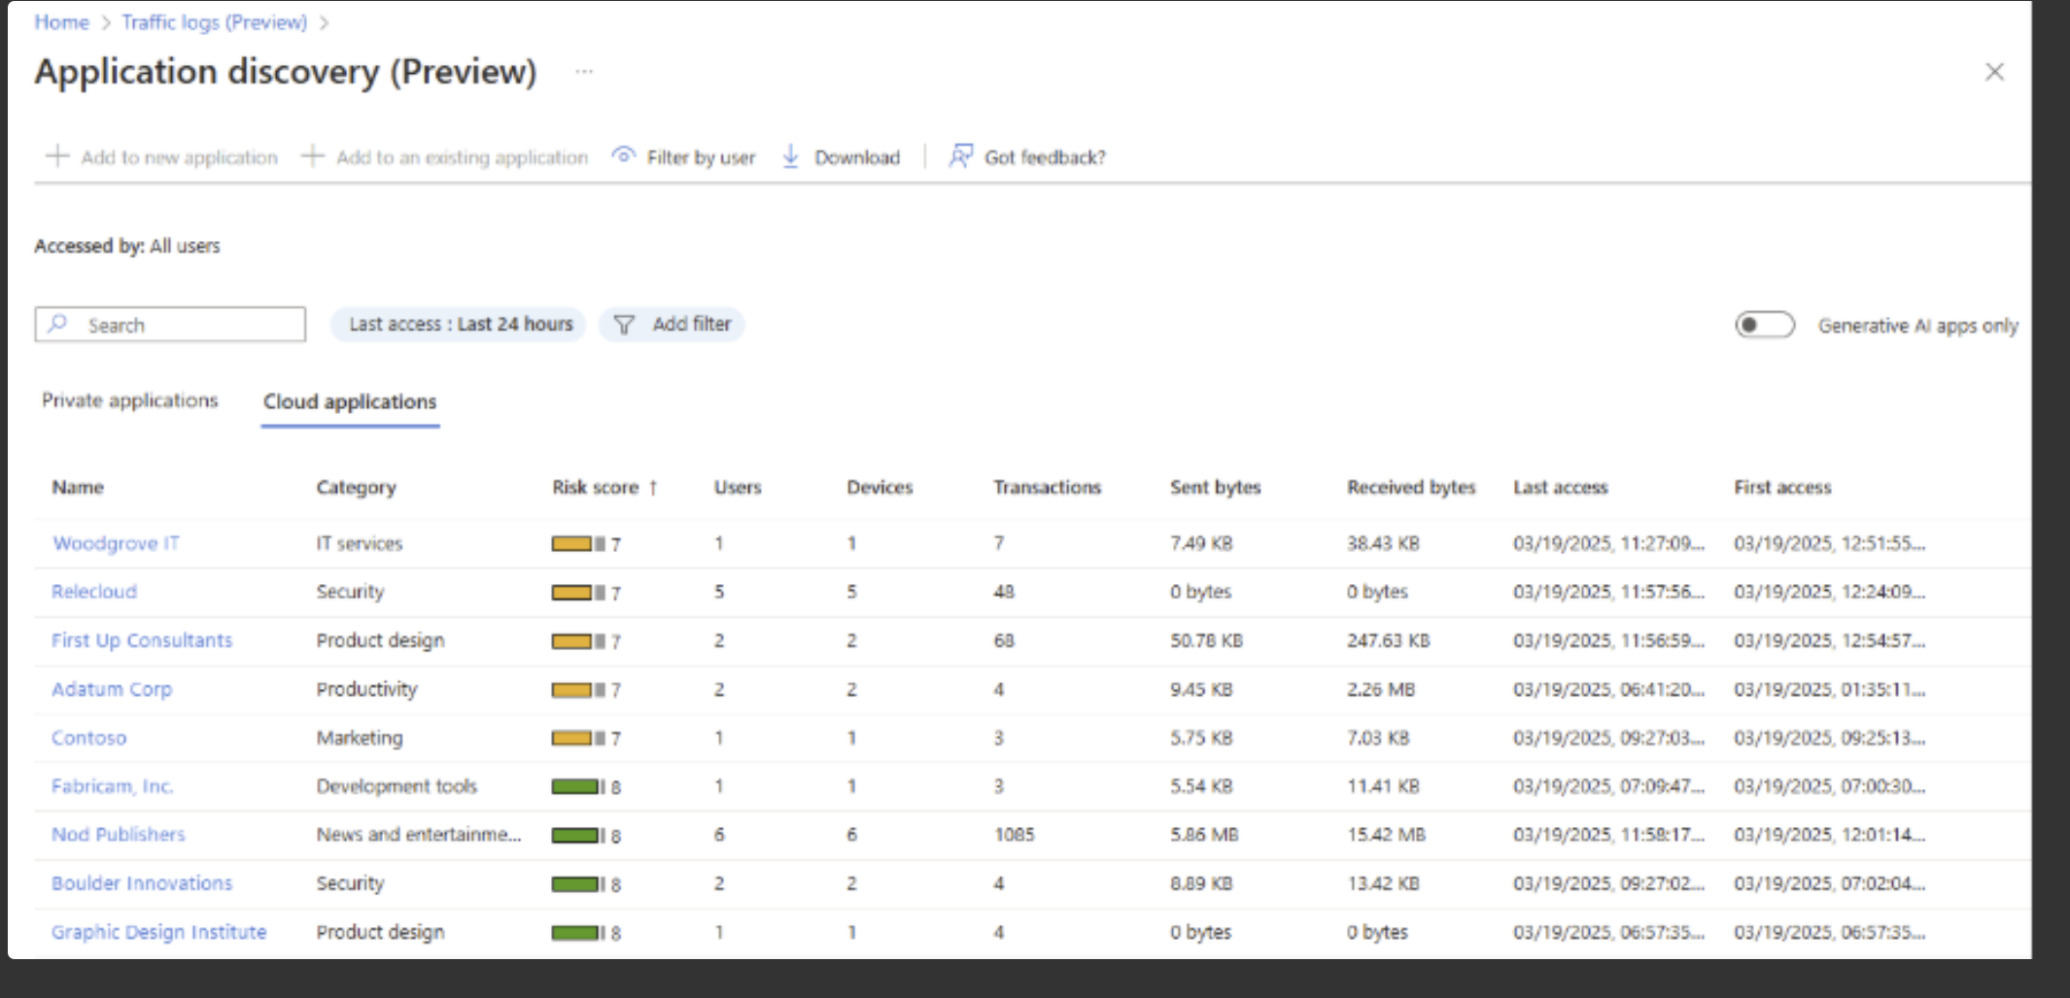
Protect against shadow AI (Entra GSA & MDA)
Generative AI is changing workplace processes, with 75% of knowledge workers already using tools like Copilot, ChatGPT or Cursor. However, many use generative AI tools without IT approval, creating risks such as compliance issues, data exposure, and operational gaps.
To close this gap, Microsoft Entra Internet Access introduces three new capabilities:
Application insights & analytics (shadow AI & IT discovery) – now in public preview
Threat intelligence filtering
Netskope One Advanced Security Service Edge (SSE) integration now in public preview
Notes:
https://techcommunity.microsoft.com/blog/microsoft-entra-blog/uncover-shadow-ai-block-threats-and-protect-data-with-microsoft-entra-internet-a/4440787

Slide 13
Community Tools/Scripts
IntuneDocumentation
IntuneDiag
IntuneDiff
Envoy
Detect impact MFA enforcement
Notes:
Intune Documentation by Ugur
Free Intune Documentation Generator | Microsoft Intune PDF Export Tool
https://www.intunedocumentation.com/
Intunediag by Maksymillian Olowski
Intune dsregcmd Analyzer - Microsoft Intune Device Registration Troubleshooting
https://www.intunediag.com/
IntuneDiff by Sandy Zeng
First Look at IntuneDiff - MSEndpointMgr
https://msendpointmgr.com/2025/08/29/first-look-at-intunediff/
Envoy by Joey Verlinden
Envoy - Lightweight User Environment Manager
https://www.envoycontrol.com/
Detect impact MFA enforcement
Detect Impact MFA Enforcement – Blog by Morten Knudsen about Microsoft Security, Azure, M365 & Automation
https://mortenknudsen.net/?p=3230

